Slide 1
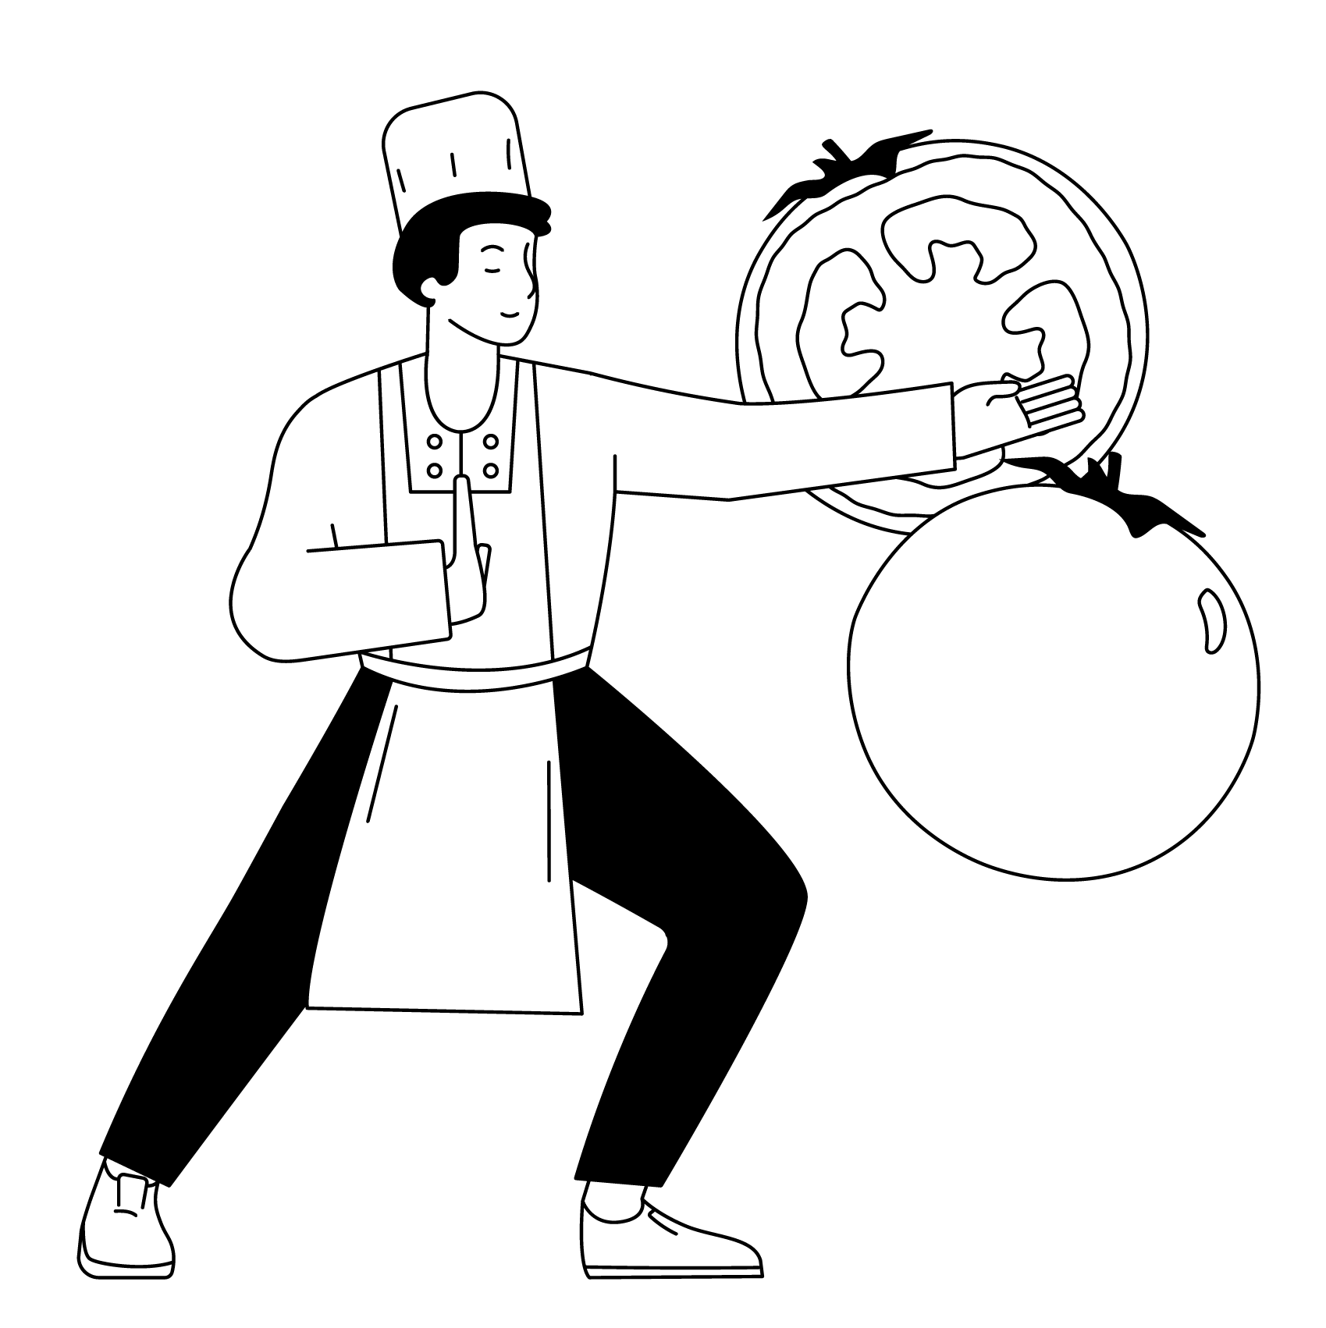
Lunch menu week one
Available everyday | Monday | Tuesday | Wednesday
Seasonal soup with croutons, fresh herbs, toppings, and freshly baked bread Everyday salads selection of healthy and colourful salads Fruit bar selection of bananas, apples, satsumas, melon and mixed grapes Yoghurt bar selection of natural yoghurts Jacket potato or Pasta hot jacket potatoes with a choice of fillings or past dish of the day | Main meal Freshly Made Margarita Pizza Vegetarian Meal Roasted vegetable pizza Sides Potato Wedges, Peas, Broccoli Dessert Syrup Flapjack | Main meal Garlic & Herb Chicken Vegetarian Meal Ratatouille Crumble Sides Herby Potatoes, Green beans, Cauliflower Dessert Blueberry & Lemon Muffin | Main meal Roast Beef, Yorkshire Pudding & Gravy Vegetarian Meal Roast Veg, Pesto & Mozzarella Strudel Sides Roast potatoes, Carrots, Steamed Savoy Cabbage Dessert Chocolate Chip Cookie
 | Thursday | Friday
 | Main meal Beef Chilli-con-carne Vegetarian Meal Bean Chilli Sides Rice, Spiced Cauliflower, Green Beans, Tortilla Chips Dessert Eton Mess | Main meal Battered Fish Vegetarian Meal Vegan Fishless Finger Sides Oven chips, Garden peas, Baked beans Dessert Orange Drizzle Cake
Please see daily menu boards
for ALL allergens
*All menus are subject to change due to availability and supply

Slide 2
Lunch menu week two
Available everyday | Monday | Tuesday | Wednesday
Seasonal soup with croutons, fresh herbs, toppings, and freshly baked bread Everyday salads selection of healthy and colourful salads Fruit bar selection of bananas, apples, satsumas, melon and mixed grapes Yoghurt bar selection of natural yoghurts Jacket potato or Pasta hot jacket potatoes with a choice of fillings or past dish of the day | Main meal Quorn Burger Vegetarian Meal Curried Lentils topped with Potatoes & Spinach Sides Wedges, Broccoli, Peas Dessert Chocolate Shortbread | Main meal Beef Bolognaise Vegetarian Meal Plant Balls in a Rich Tomato Sauce Sides Spaghetti, Cauliflower, Green beans Dessert Carrot Cake | Main meal Roast Chicken & Stuffing Vegetarian Meal Stuffed Pepper Sides Roast Potatoes, Carrots, Sauted Leeks & Greens Dessert Ginger Cake
 | Thursday | Friday
 | Main meal Spanish Chicken Vegetarian Meal Potato & Onion Tortilla Sides Rice, Roasted Squash, Sweetcorn Dessert Apple Crumble Shortbread Slice | Main meal Chicken Goujons Vegetarian Meal Quorn Nuggets Sides Oven chips, Garden peas, Baked beans Dessert Raspberry & White Chocolate Flapjack
Please see daily menu boards
for ALL allergens
*All menus are subject to change due to availability and supply

Slide 3
Lunch menu week three
Available everyday | Monday | Tuesday | Wednesday
Seasonal soup with croutons, fresh herbs, toppings, and freshly baked bread Everyday salads selection of healthy and colourful salads Fruit bar selection of bananas, apples, satsumas, melon and mixed grapes Yoghurt bar selection of natural yoghurts Jacket potato or Pasta hot jacket potatoes with a choice of fillings or past dish of the day | Main meal Veggie Sausage Roll Vegetarian Meal Cheese & Roasted Tomato Quiche Sides Potato Wedges, Cauliflower, Carrots Dessert Anzac Biscuit | Main meal Mexican Chicken Vegetarian Meal Roasted Squash & Pepper Fritatta Sides Rice, Green Beans, Roasted Courgette Dessert Banoffee Pie | Main meal Roast Pork Yorkshire Pudding, Gravy Vegetarian Meal Tomato & Butter Bean Stew with Basil Dumplings Sides Roasted Potatoes, Carrots, Savoy Cabbage Dessert Chocolate Muffin
 | Thursday | Friday
 | Main meal Stir Fried Chicken Vegetarian Meal Crispy Tofu Sides Noodles, Broccoli, Sweetcorn Dessert Cornflake Cake | Main meal Build your own Chicken wrap Vegetarian Meal Sweet potato & Bean Falafel Sides Oven chips, Garden peas, Baked beans Dessert Ginger Oat Cookie
Please see daily menu boards
for ALL allergens
*All menus are subject to change due to availability and supply

